Slide 1
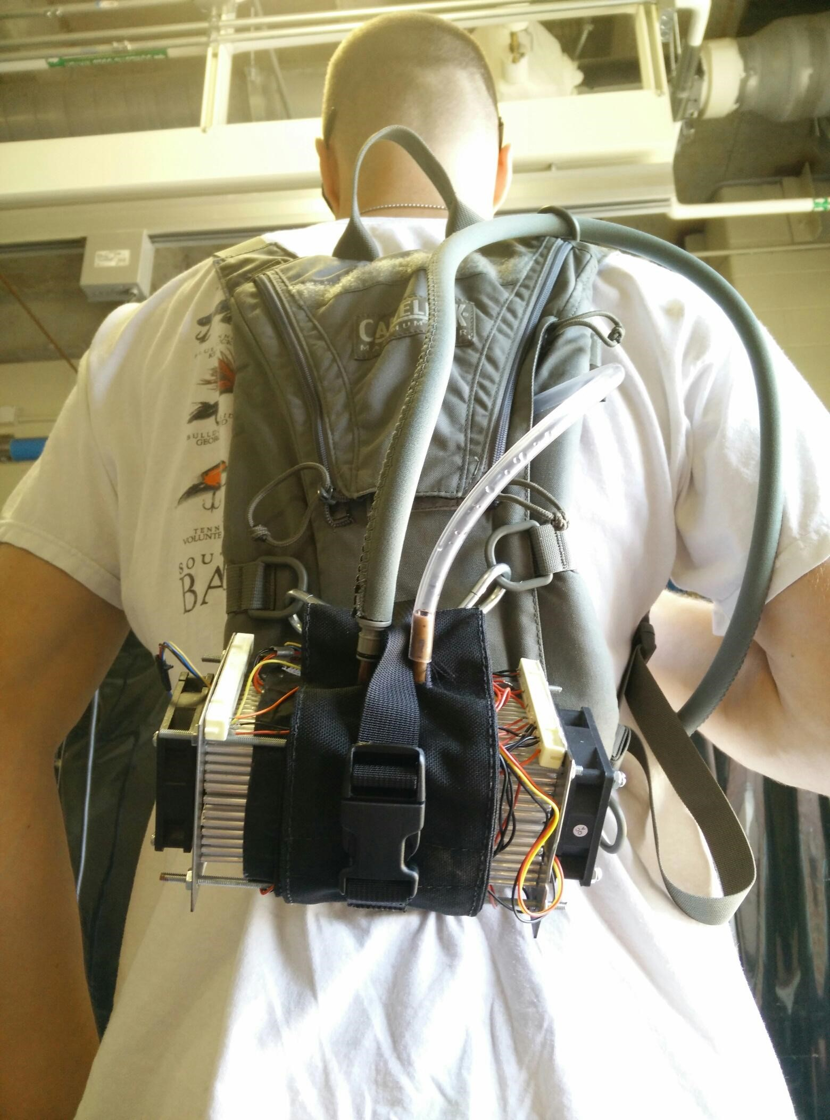

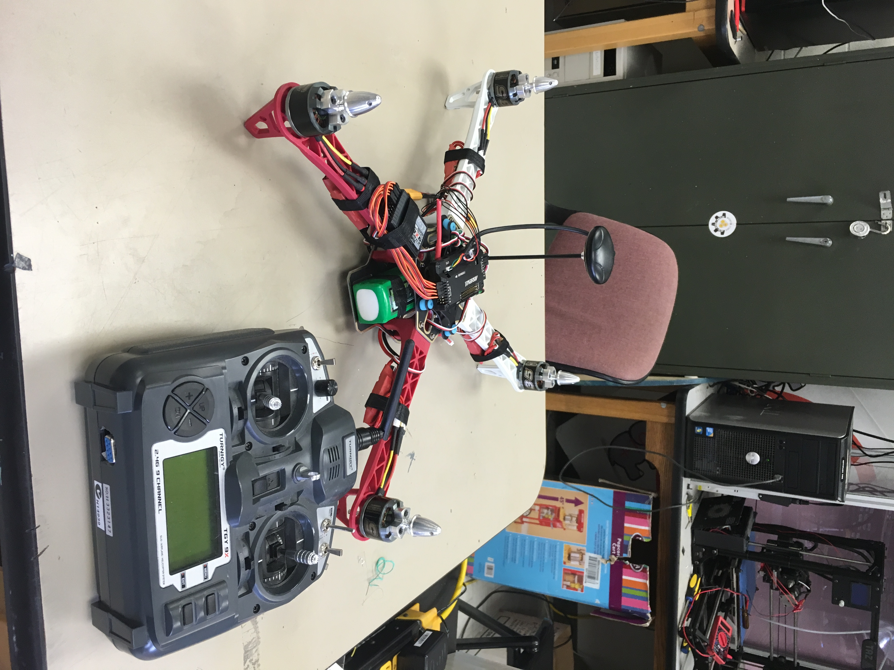
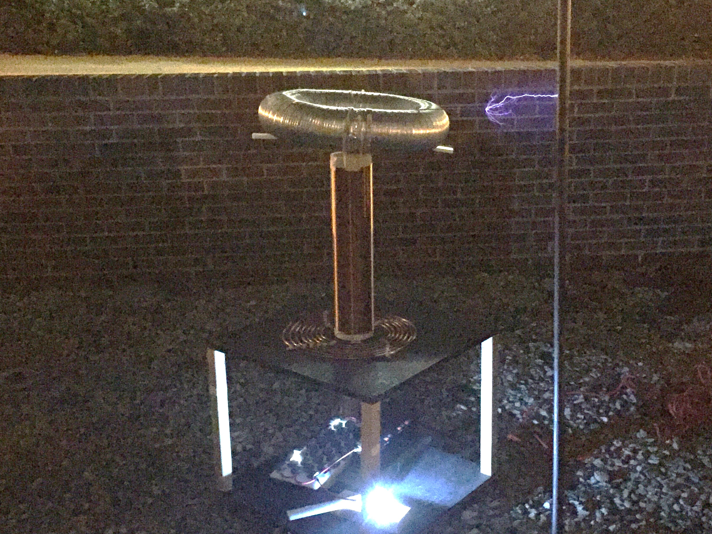
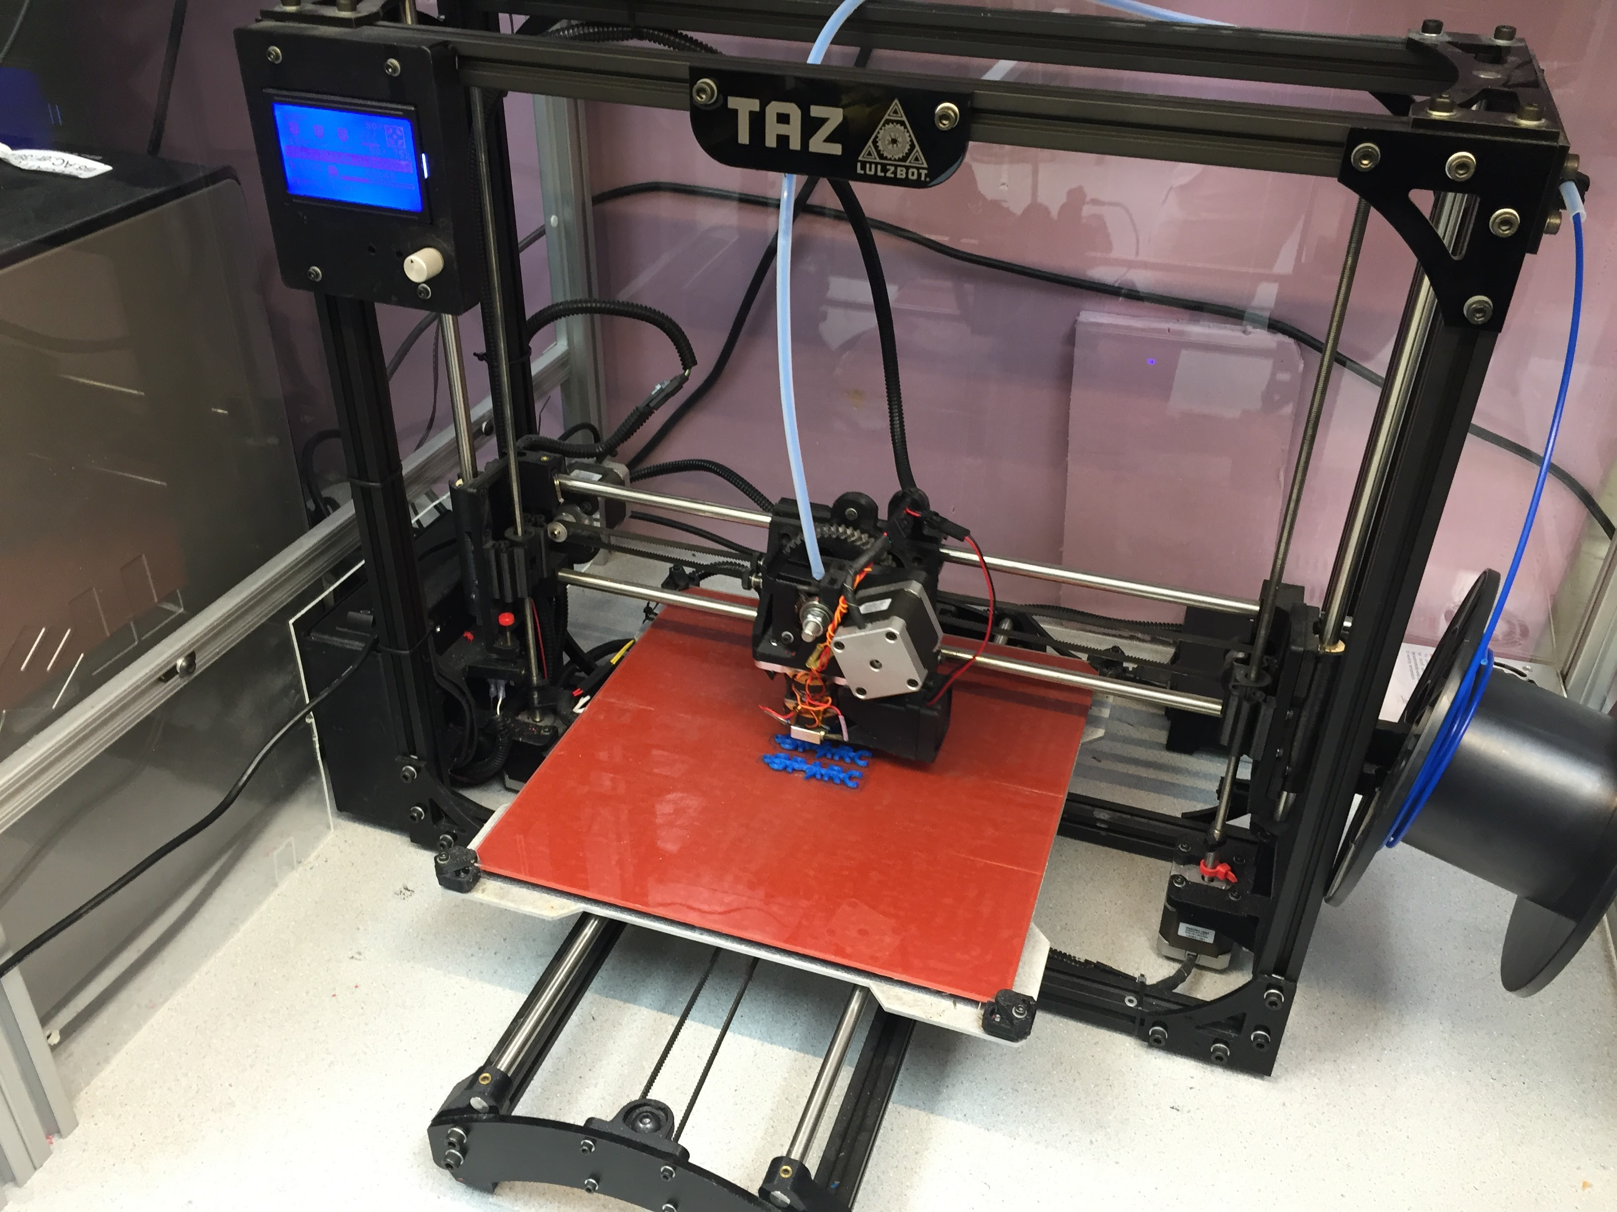
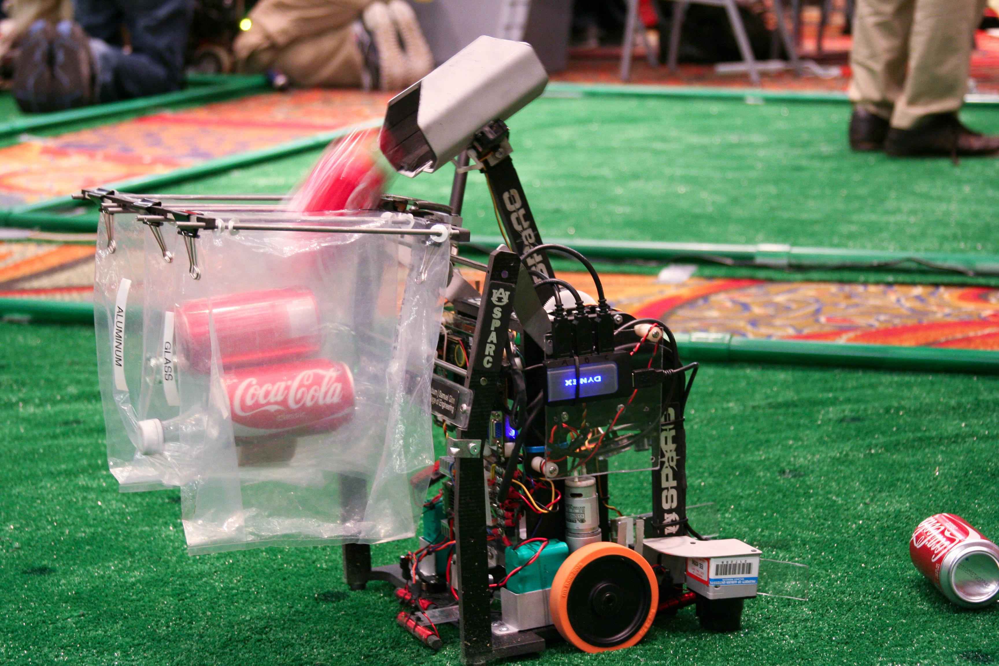
Looking for hands-on project experience?
Collaborative learning environment
Circuit Design
3D printing
Robotics
CAD
And more!
No past experience required
Come join us:
Fall 2018 Weekly Meetings:
Tuesdays 6-7 PM
Broun 125
Lab Location:
Broun Hall 367
Website
http://sparc-auburn.github.io/
Email
sparc.auburn@gmail.com
Slack
https://sparc-auburn.slack.com/

